Slide 1
Languages and Compilers
(SProg og Oversættere)
Language Design
and Control structures

Slide 2
Language Design and control structures
  Language Design Criteria
  Relate language design criterial to the following consepts
  Evaluation of expressions
  Explicit vs. implicit sequence control
  Loop constructs
  Subprogram
  Parameter mechanisms

Slide 3
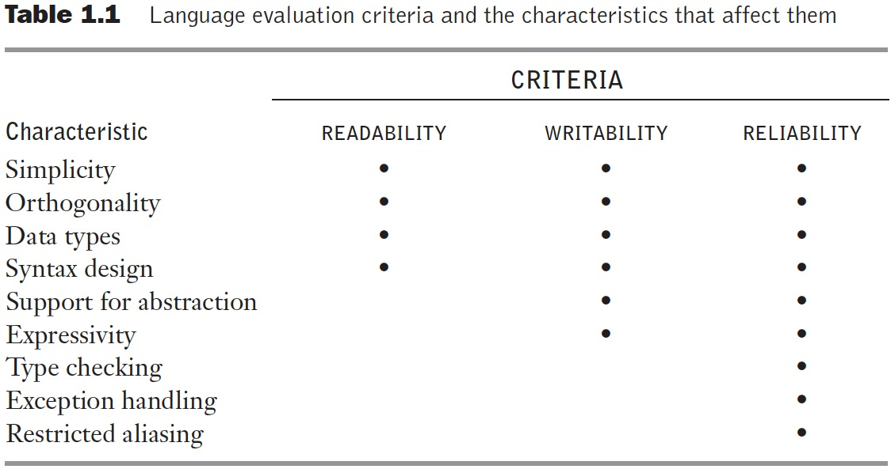
Table 1.1 Language evaluation criteria and the characteristics that affect them
Notes:
Orthogonality
A relatively small set of primitive constructs can be combined in a relatively small number of ways
Every possible combination is legal
Lack of orthogonality leads to exceptions to rules

Slide 4
Sequence control
Implicit and explicit sequence control
  Expressions
    Precedence rules
    Associativity
    Operand evaluation order
  Statements
    Sequence
    Conditionals
    Loop constructs
    unstructured vs. structured sequence control
  Subprograms
    Parameter mechanisms

Slide 5
Expression Evaluation
Determined by
  operator evaluation order
  operand evaluation order
Operators:
  Most operators are either infix or prefix (some languages have postfix)
  Order of evaluation determined by operator precedence and associativity

Slide 6
Example
What is the result for:
  3 + 4 * 5 + 6
Possible answers:
  41 = ((3 + 4) * 5) + 6
  47 = 3 + (4 * (5 + 6))
  29 = (3 + (4 * 5)) + 6 = 3 + ((4 * 5) + 6)
  77 = (3 + 4) * (5 + 6)
In most language, 3 + 4 * 5 + 6 = 29
… but it depends on the precedence of operators

Slide 7
An Ambiguous Expression Grammar
How to parse 3+4*5?
<expr> → <expr> <op> <expr> | const
<op> → + | *
<expr>
<expr>
<expr>
<op>
<expr>
<op>
<expr>
<op>
<expr>
<expr>
<op>
<expr>
<expr>
<op>
<expr>
const
+
const
*
const
const
+
const
*
const

Slide 8
Expressing Precedence in grammar
We can use the parse tree to indicate precedence levels of the operators
<expr> → <expr> + <term> | <term>
<term> → <term> * const | const
In LALR parsers we can specify
Precedence which translates into
Solving shift-reduce conflicts
Note in LL(1) parsers we have to use
Left recursion elimination
<expr>
<expr>
+
<term>
Expr → Term Expr1 .
Expr1 → + Term Expr1
| .
Term → const Term1 .
Term1 →* const Term1
| .
<term>
<term>
*
const
const
const

Slide 9
Operand Evaluation Order
Example:
A := 5;
f(x) = {A := x+x; return x};
B := A + f(A);
What is the value of B?
10 or 15?

Slide 10
Solution to Operand Evaluation Order
Disallow all side-effects in expressions but allow in statements
  Problem: not applicable in languages with nesting of expressions and statements
Fix order of evaluation
  SML does this – left to right
  Problem: makes some compiler optimizations hard or impossible
Leave it to the programmer to be sure the order doesn’t matter
  Problem: error prone
  Fortress: Parallel evaluation unless specified to be sequential

Slide 11
Control of Statement Execution
Sequential
Conditional Selection
Looping Construct
Must have all three to provide full power of a Computing Machine

Slide 12
For-loops
Controlled by loop variable of scalar type with bounds and increment size
Scope of loop variable?
  Extent beyond loop?
  Within loop?
When are loop parameters calculated?
  Once at start
  At beginning of each pass

Slide 13
Logic-Test Iterators
While-loops
  Test performed before entry to loop
repeat…until and do…while
  Test performed at end of loop
  Loop always executed at least once
Design Issues:
  1. Pretest or posttest?
  2. Should this be a special case of the counting loop statement (or a separate statement)?

Slide 14
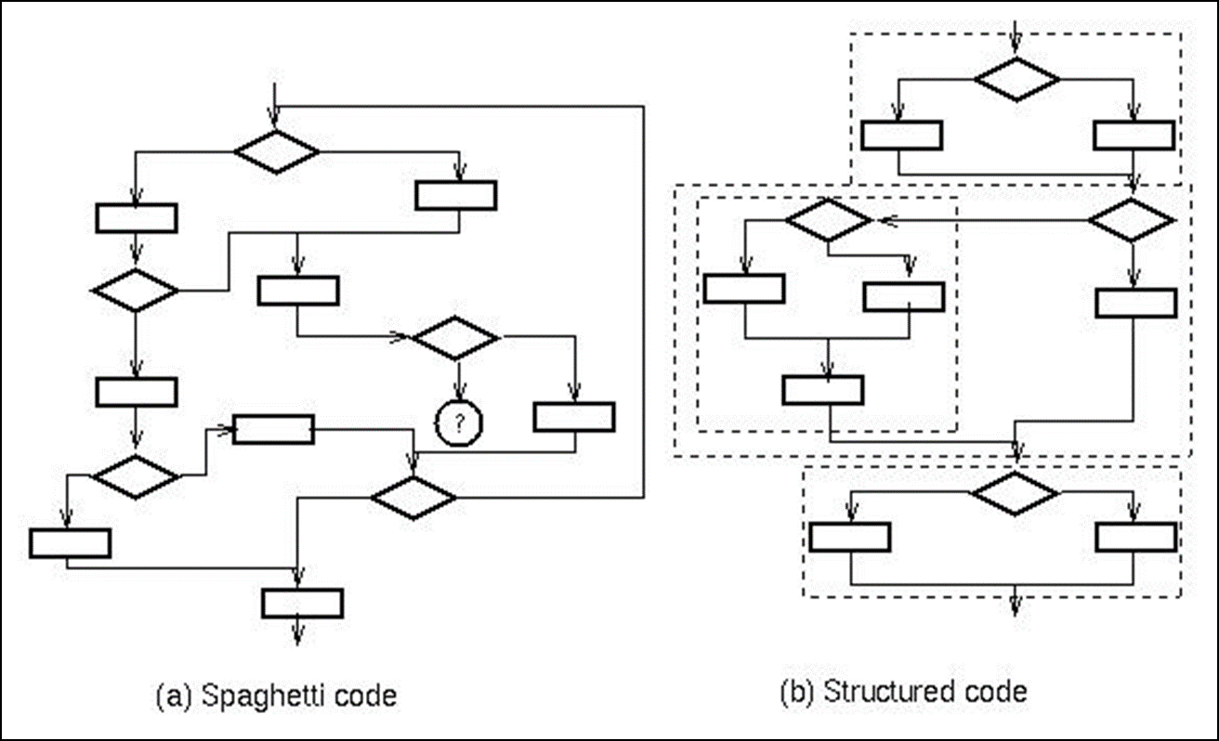

Gotos
Requires notion of program point
Transfers execution to given program point
Basic construct in machine language
Implements loops

Slide 15
Exceptions: Structured Exit
Terminate part of computation
  Jump out of construct
  Pass data as part of jump
  Return to most recent site set up to handle exception
  Unnecessary activation records may be deallocated
    May need to free heap space, other resources
Two main language constructs
  Declaration to establish exception handler
  Statement or expression to raise or throw exception
Often used for unusual or exceptional condition, but not necessarily.

Slide 16
Subprograms
A subprogram has a single entry point
The caller is (normally) suspended during execution of the called subprogram
Control (normally) returns to the caller when the called subprogram’s execution terminates
Functions or Procedures?
Procedures provide user-defined statements
    Abstractions over statements
Functions provide user-defined operators
    Abstractions over expressions
Methods used for both functions and procedures

Slide 17
Subprogram Parameters
Formal parameters: names (and types) of arguments to the subprogram used in defining the subprogram body
Actual parameters: arguments supplied for formal parameters when subprogram is called
Actual/Formal Parameter Correspondence:
  attributes of variables are used to exchange information
    Name – Call-by-name
    Memory Location – Call-by reference
    Value
      Call-by-value (one way from actual to formal parameter)
      Call-by-value-result (two ways between actual and formal parameter)
      Call-by-result (one way from formal to actual parameter)

Slide 18
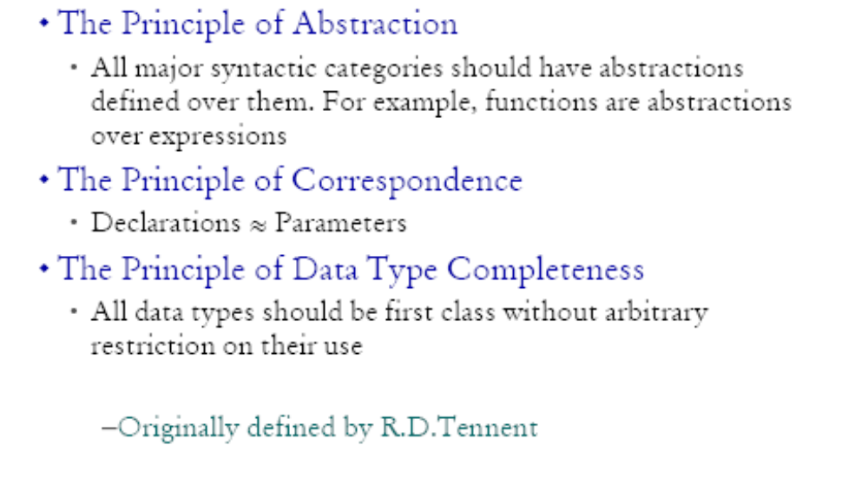
Tennent’s Language Design principles

Slide 19
Example of missing correspondence
In Pascal:
procedure inc(var i : integer);
begin
i := i + 1
end;
var x : integer;
begin
x := 1;
inc(x);
writeln(x);
end
No corresponding declaration
However C has correspondence
void inc(int *i) {
*i = *i + 1;
}
int x = 1;
inc(&x);
printf("%d", x);
int x = 1;
{
int *i = &x;
*i = *i + 1;
}
printf("%d", x);

